Slide 1
TOURISM WEBSITE PROJECT
City of Pearls — Tourism Website
Greater Hyderabad
Presented by
Purni Subramanyam
Frontend Project | HTML5 · CSS3 · Responsive Design

Slide 2
Introduction
1
2
3
Project Concept
Scope & Outline
Core Tech Stack
A complete tourism website presenting Hyderabad — the “City of Pearls” — covering its heritage monuments, temples, parks, museums, cuisine, shopping and culture for prospective visitors.
11 interconnected pages: Home, Places, Heritage, Temples, Parks, Museums, Food, Shopping, Gallery, About and Contact — each with its own hero, content sections and consistent navigation.
Built with plain HTML5 and CSS3 — 8 stylesheets split by responsibility, hand-crafted, fully static site.
02

Slide 3
Project Objectives
1
2
3
4
Showcase the Destination
Multi-Page Navigation
Visual Storytelling
Consistent Design System
Use hero sections, photo galleries, an animated carousel and a historical timeline to bring the city to life.
Present Hyderabad's monuments, culture, food and shopping in a visually rich, card-based format that inspires travel.
Build a single, identical navbar repeated across all 11 pages so visitors can move seamlessly between categories.
Apply one shared set of colours, fonts, shadows and spacing tokens across every page and every component.
03

Slide 4
Core Technologies — Structure & Layout
Semantic Structure
Modern Layout Engines
Design Tokens (:root)
<nav> <section> <article> <footer>
CSS Grid
CSS Custom Properties
Semantic HTML5 sectioning on every page
Card grids, footer columns, filter/emergency layouts
Colours, fonts, radii, shadows & transitions — one source of truth
<div class="container">
Flexbox
3 Font Families
Centred, max-width content wrapper (1200px)
Navbar, buttons, card headers, form rows
Playfair Display (headings) · Poppins (body) · Inter (UI)
05

Slide 5
Core Technologies — Motion & Interactivity
单击此处编辑母版文本样式
第二级
第三级
第四级
第五级
Keyframe Animations
CSS-Only Interactions
Responsive Breakpoints
Auto-Playing Carousel
fadeIn, float, pulse, glow, shimmer, spin, gradientShift & more
Mobile nav menu & gallery filter — built with :checked, zero JavaScript
From 1400px desktops down to 374px phones, in one dedicated stylesheet
A 7-photo carousel cycles continuously using only CSS keyframe timing
06

Slide 6
Key Features
1
2
3
4
Unified Navigation
Reusable Card Library
CSS-Driven Carousel
Fully Responsive
A fixed, frosted-glass navbar with an animated underline repeats identically across all 11 pages.
4 distinct card families (place, detail, shop, food) built once in cards.css and reused across every listing page.
A 7-photo gallery preview cycles endlessly using staggered negative animation-delays — no JS required.
7 breakpoints reshape every grid, form and navbar from large desktops down to small phones.
07

Slide 7
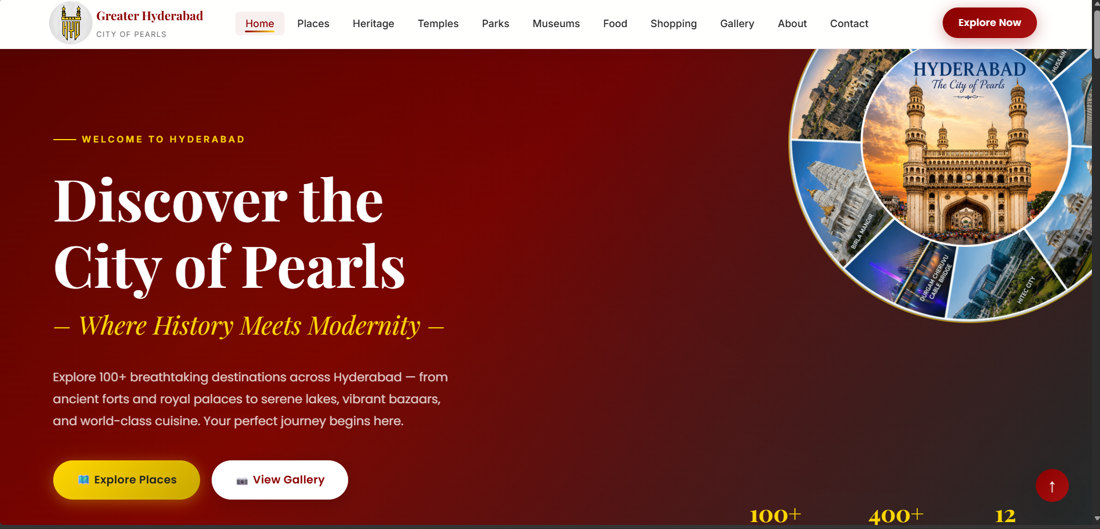
Home Page
Hero banner with rotating emblem, stats bar and dual call-to-action buttons
08

Slide 8
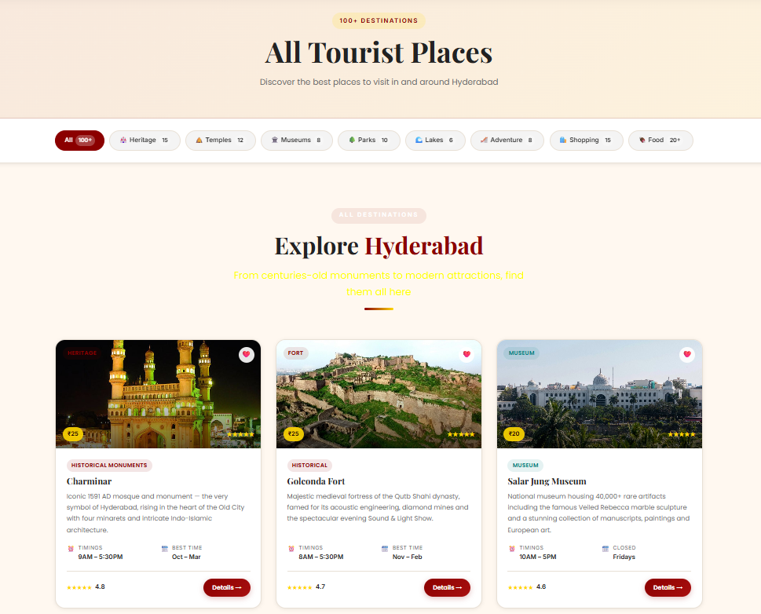
All Places — Listing Page
Filter bar plus a 3-column grid of destination cards with ratings, timings & entry fees
09

Slide 9
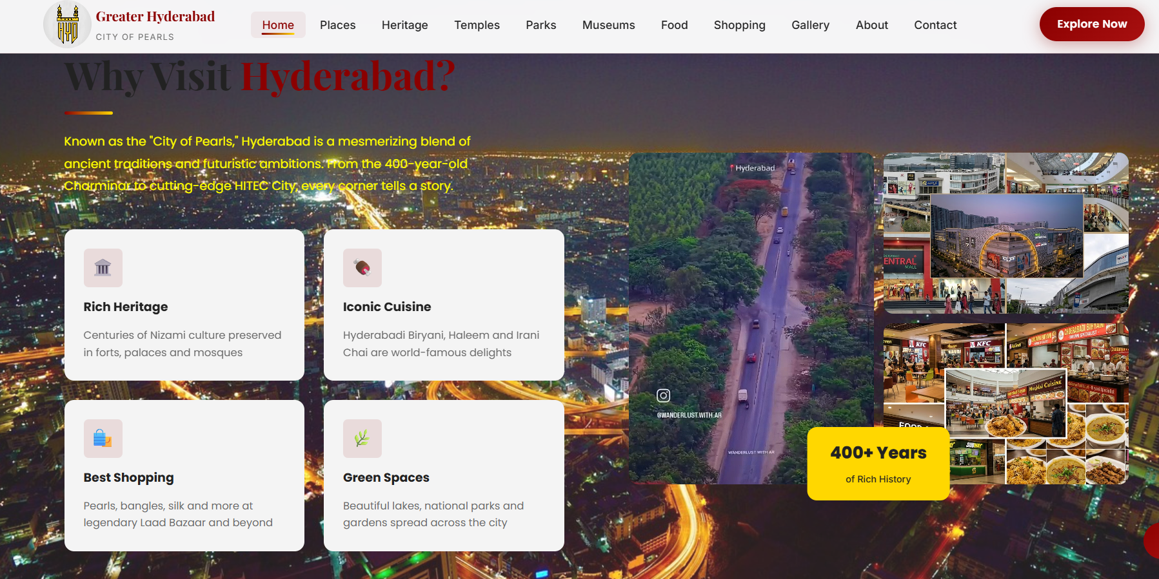
Why Visit Hyderabad
Feature tiles, an image collage and a floating “400+ Years” badge on the homepage
10

Slide 10
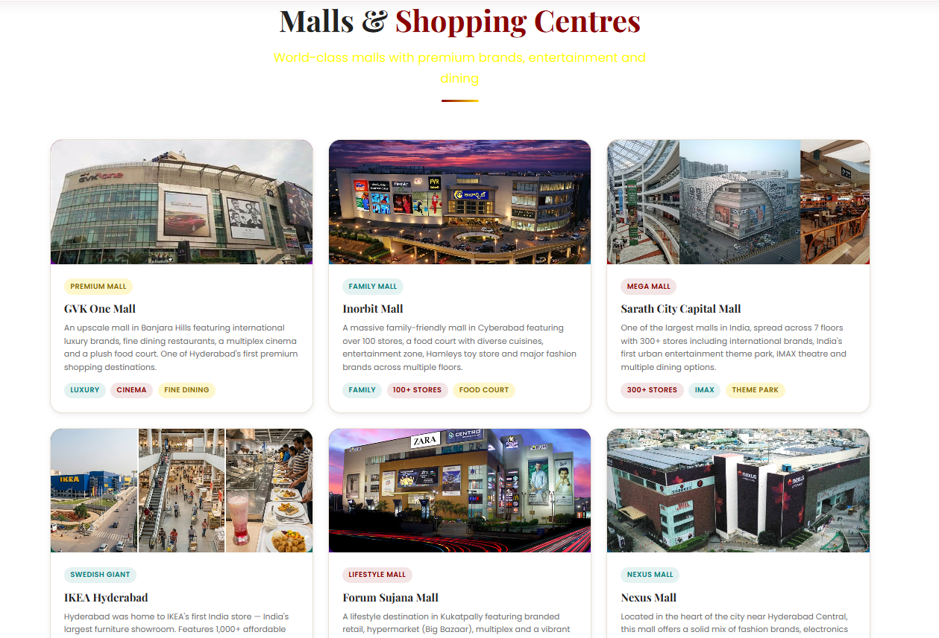
Shopping — Malls & Centres
Shop-card grid with tagged highlights (Luxury, Family, Mega Mall, IMAX...)
11

Slide 11
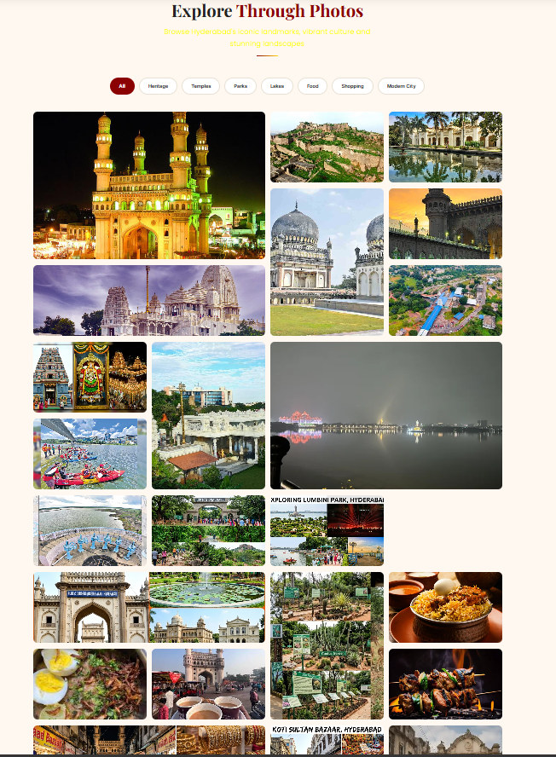
Gallery — Explore Through Photos
CSS-only category filters above a responsive photo masonry grid
12

Slide 12
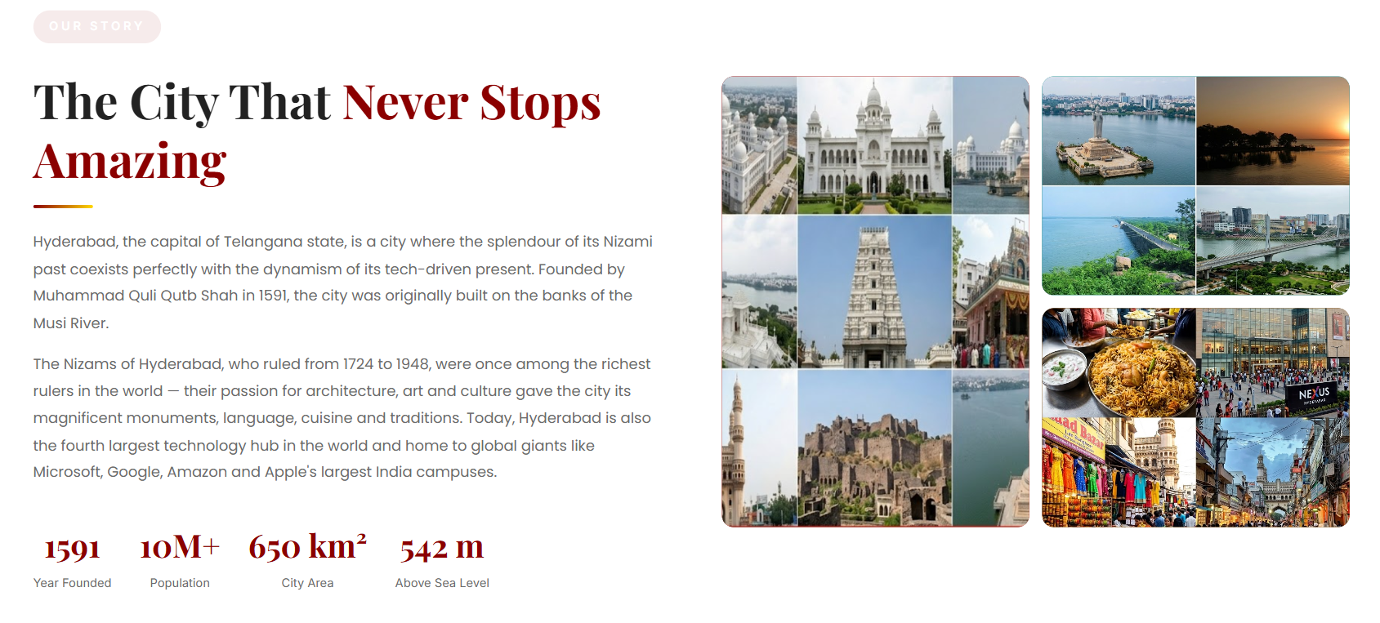
About — Our Story
City narrative and key statistics beside a photo collage of Hyderabad's landmarks
14

Slide 13
Challenges Faced
1
2
3
4
Carousel Animation Math
Consistency Across 8 Stylesheets
CSS-Only Interactivity
Cross-Page Consistency
Getting the 7-card gallery carousel to loop seamlessly required precise keyframe percentages and negative animation-delay staggering.
Keeping colours, spacing and typography identical across style, home, cards, about, contact, gallery, animation & responsive CSS.
Building a working mobile menu and gallery filter using only the :checked pseudo-class, without any JavaScript.
Repeating the navbar and footer identically across 11 separate HTML files with no shared template engine.
15

Slide 14
Learnings & Outcomes
1
2
3
4
CSS Architecture
Advanced Animation
Responsive Design Strategy
Component Thinking
Learned to split stylesheets by responsibility (foundation, layout, components, motion, responsive) for a maintainable codebase.
Gained hands-on experience with keyframes, animation-delay staggering, and 3D perspective hover effects.
Practiced structuring a full breakpoint system from large desktops down to small mobile phones.
Built a reusable card library and design-token system that scales cleanly across 11 pages.
16

Slide 15
Conclusion & Future Scope
1
Successful Project Completion
All 11 pages meet the planned structure, navigation, and visual-design goals set out at the start of the project.
2
A Strong, Reusable Foundation
The design-token and component system is clean enough to extend with new pages or categories with minimal extra CSS.
3
Next Steps
Add a real backend for the contact form, JavaScript-powered search/filtering, and a CMS to manage places dynamically.
Thank You

